Slide 1
Welcome class of 2027! Remind sign up
https://www.remind.com/join/kowboy27

Slide 2
WELCOME TO Osceola HIGH SCHOOL
New Student Orientation
Inspiring all learners to reach their highest potential as responsible, productive citizens.

Slide 3
Welcome new students
Goals for Today:
Introduce counseling team
Diploma options
Graduation Requirements
GPA CALCULATION
Post secondary plan
Academic Programs (AP, AVID, de, cte)
9th grade Sample schedules
Athletics and Clubs
9th grade tips

Slide 4
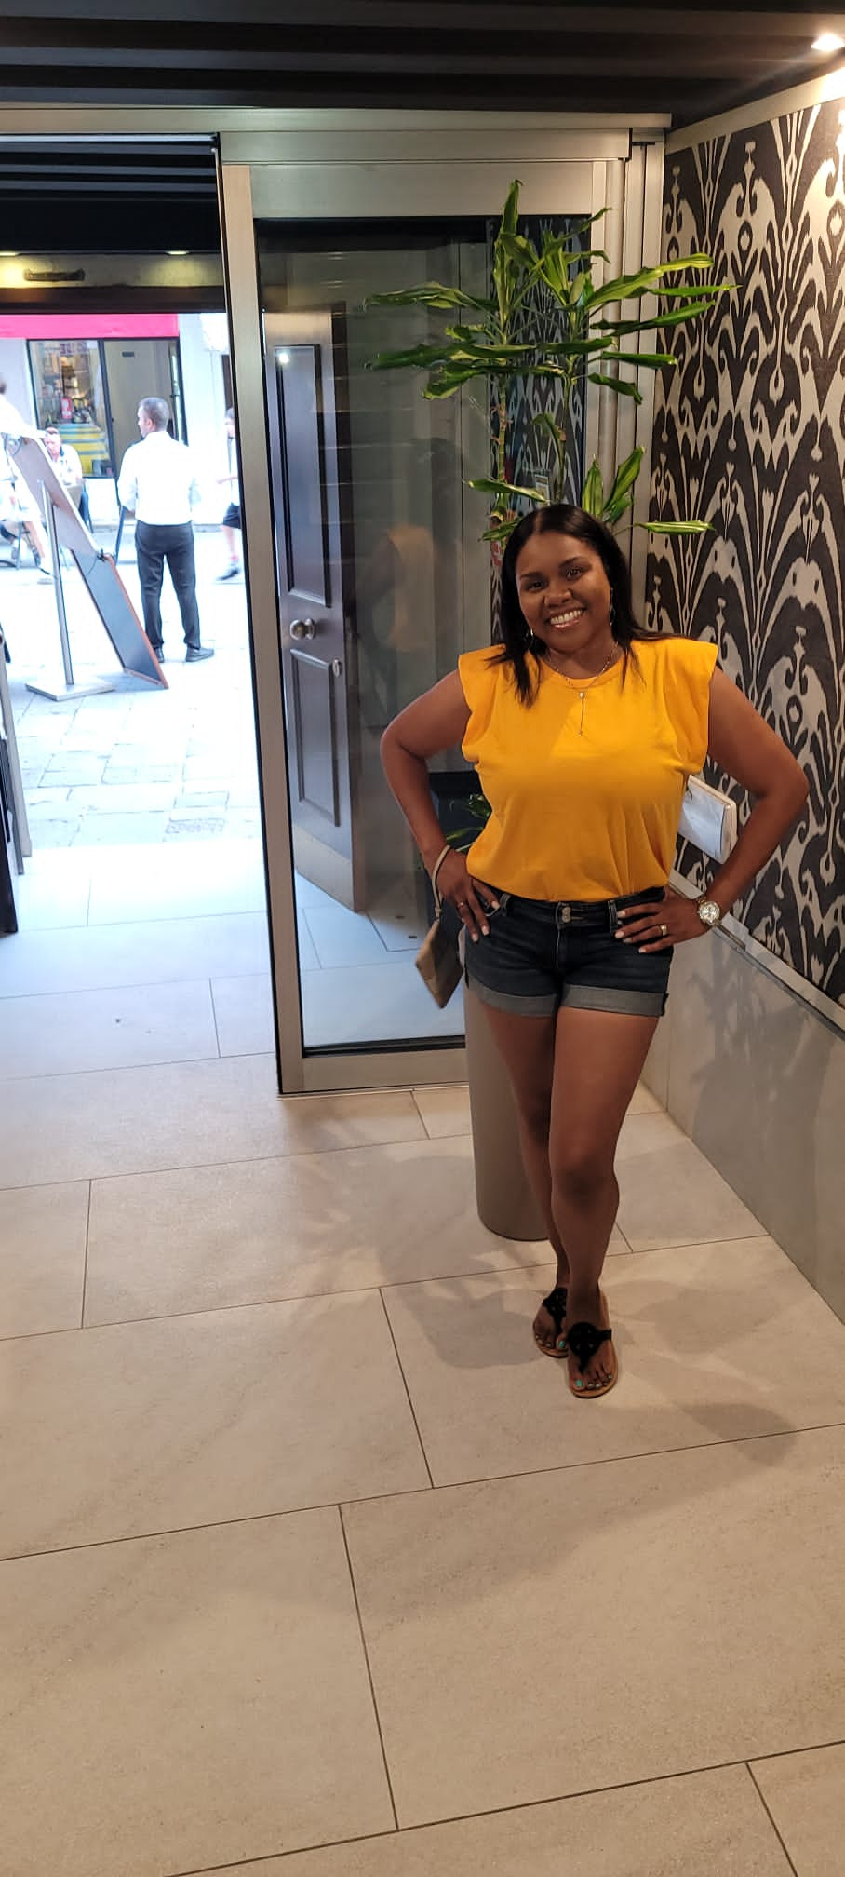
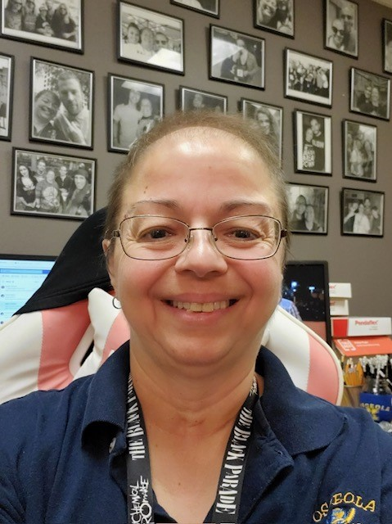
A – Go: Clarke, Nuria
Gr – Pe: Balladin, Devyani
Pi – Z: Morales, Imaris
9th & 10th Grade Counselors

Slide 5
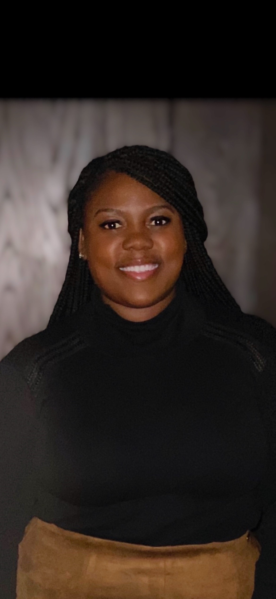
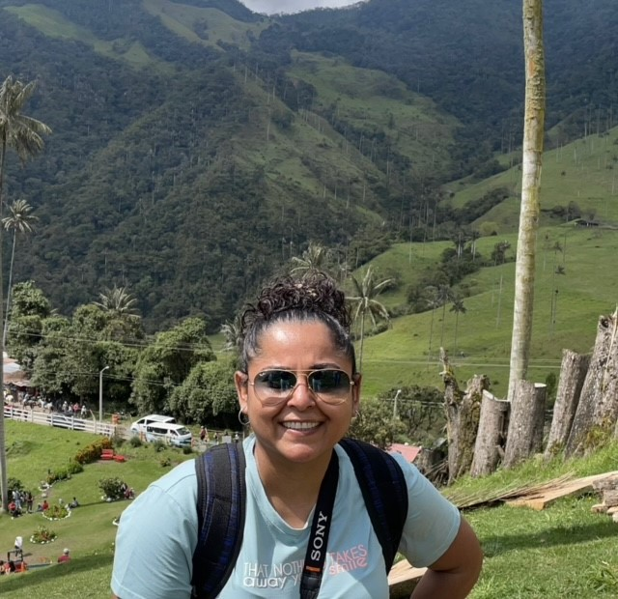
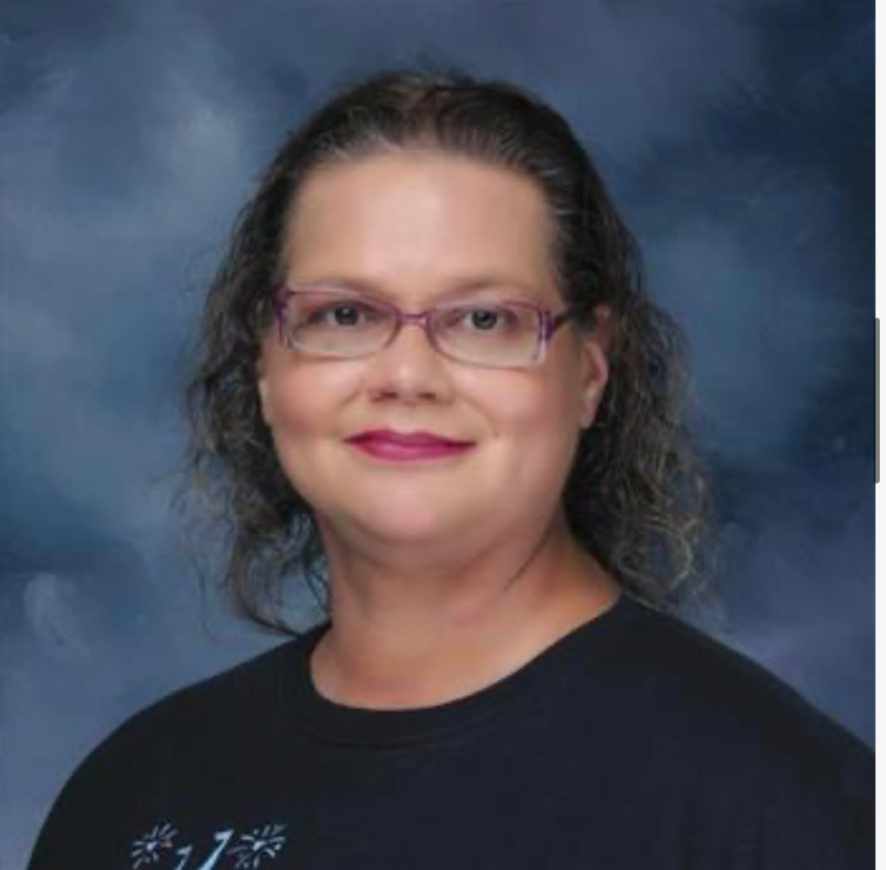
A – D: Wilkerson, Shaniqua
E – L: Ortiz, Deysi
M – Re: Zuniga, Adriana
Ri – Z: Warren, Larry
11th & 12th Grade Counselors

Slide 6
Diploma options
24-credit option
Scholar
merit
18-credit Academically Challenging Curriculum to Enhance Learning (ACCEL) option

Slide 7
GRADUATION REQUIREMENTS
24 Credits
2.0 GPA
1 online course completion (Pending Change)
Level 3 or higher in the 10th grade Reading FAST
Level 3 or higher in the Algebra 1 BEST EOC
*Other Important Tests
Geometry, Biology, US History EOC = 30% of overall grade

Slide 8
Credit Breakdown
ENGLISH (4 Credits)
4.0 English
PHYSICAL ED. (PE) (1 Credit)
HOPE or
Personal Fitness & 1 other PE class
PERFORMING ARTS (1 Credit)
ELECTIVES (8 Credits)
2 credits in the same world language are required for admission into state universities (Not High School Graduation)
MATH (4 Credits)
Algebra I
Geometry
2 additional Math credits
SCIENCE (3 Credits)
Biology
2 additional Science credits
SOCIAL STUDIES (3.5 Credits)
Personal Financial Literacy (0.5)
World History
US History
Government & Econ. w/ Fin. Lit

Slide 9
Gpa calculation
Unweighted GPA Points
A=4.0 points
B= 3.0 points
C=2.0 points
D=1.0 points
F=0 points
Weighted GPA
Honors is .5 point weight
A=4.5 points
B= 3.5 points
C=2.5 points
D=1.5 points
F=0 points
Weighted GPA
AP/IB/DE is 1 point weight
A=5 points
B= 4 points
C=3 points
D=2 points
F=0 points
If you made all C’s in every class you took this would give you a 2.0 Unweighted GPA which is what is required for graduation.

Slide 10
ACADEMIC PROGRAMS

Slide 11
ADVANCED PLACEMENT (AP)
CollegeBoard Accelerated program
College level courses and rigor
Earn college credit by passing test at the end of the year with 3 or better.
Universities like to see students challenging themselves with academic course work.

Slide 12
DUAL ENROLLMENT OPPORTUNITIES

Slide 13
CTE and industry certification
The courses below offer the following Industry Certifications:
Private Ground Pilot
Business & Entrepreneurial
Culinary Arts 2
Digital Media 1
Digital Media 2
Game & Simulation Foundations
Game & Simulation Design
Game & Simulation Programming
Multi-User Game & Simulation
Hospitality & Tourism Marketing Management
Media Production
Digital Design 1
Allied Health 3 (Phlebotomy)
Adobe Certifications
-Photoshop
-Illustrator

Slide 14
9TH GRADE SAMPLE SCHEDULES
Standard 9th grade schedule
English 1
Algebra 1
Env. Science
Personal fitness/PE elective
Per. Fin Lit/Leadership or Virtual
Elective or Int. Reading (Level 1)
Elective
Accelerated 9th grade schedule
English 1 honors
Algebra 1 honors or Geometry
Biology honors
AP Human Geography
Foreign Language
Personal fitness/ PE elective
Elective
Pers. Fin Lit- Honors (Online)

Slide 15
Get Involved!!!!
Athletics
Clubs
Ambassadors
Art Club
Chess Club
Glee Club
Gears Club
Interact Club
Job Shadowing
Junior Class Office
Keyettes
National Honor Society
National Technical Honor Society
Senior Class Office
Spanish Honor Society
Speech & Debate
Latinos in Action
Weightlifting
Soccer
Wrestling
Baseball
Softball
Track & Field
Cross Country
Flag Football
Swimming
Football
Basketball
Volleyball
Tennis
Cheerleading
Swim
Golf

Slide 16
Tips for students
Attendance is very important! Be at school EVERYDAY!
Get to know your counselor.
Build relationships with your teachers. (Recommendation Letters in the future may be needed)
Find fun and interesting ways to volunteer in the community or at school.
Manage your time wisely, especially with extracurricular activities.
Figure out a plan for your high school career.
Don't cram for an exam the night before.
Stay organized, even if you're not the best at it.
Grades are important from Day 1 of school to set-up future post-secondary options. Don't slack off just because it's freshman year.
Don't be afraid to ask for help

Slide 17
Questions?
THANK YOU FOR LEARNING MORE ABOUT osceola HIGH SCHOOL
407-518-5400

